Slide 1
Managing AND Leading your Safety Program: The Psychology That Just Might Make a Difference!
GregCokerDevelopment.com
ibuildcathedrals@gmail.com
270.223.8343

Slide 2
A Heartfelt Thank You to all Safety Managers!

Slide 3
20 Questions for Consideration Before We Dive into the Content

Slide 4
20 Questions
Comfortable with being Uncomfortable?
“Leading” in addition to “Managing” your safety program?
Your safety program “Over Managed” and “Under Led?”
How would you describe your safety culture?
How visionary are those who manage and lead your safety program?

Slide 5
6. Your safety manager no doubt has high IQ but what about her/his EQ?
7. Is your safety program WHY focused or more WHAT/HOW focused?
8. Do you have the Right People on the Bus, Right People in the Right Seats and have gotten the Wrong People Off the Bus?
9. How Engaged are your Employees? (26%, 55%, 19%)
10. How Motivated are your Employees?

Slide 6
11. Form-Storm-Norm-Perform (Your Teams? Org?)
12. Are you customizing your safety message(s)?
13. Stressed out? Are you/your folks “Well Ordered Souls?”
14. Reinforcing the Positive or the Negative in your safety program?
15. Interference causing more accidents than you might have realized?

Slide 7
16. Regular Debriefs? (Going Well, Getting Stuck, Do Differently?)
17. “When” (time of day) in addition to “What?”
18. A Safety Dedication in order?
19. What’s the “One Degree” you could implement in order to take your safety program to the next level?
20. What ideas from this presentation will you implement within 72 hours?

Slide 8
So Let’s Roll!
As Safely as possible of course!

Slide 9
V.U.C.A
Volatility
Uncertainty
Complexity
Ambiguity
Safety Managers/Safety Leaders must get comfortable being uncomfortable.

Slide 10
It’s NOT Management OR Leadership but rather Management AND Leadership.
Managing & Leading your Safety Program.

Slide 11
We Manage Things; We Lead People.

Slide 12
If We Know We Can Manage. If We Love We Can Lead.

Slide 13
“Most Organizations are Overmanaged and Under led.”
-Warren Bennis (author, professor, know as one the “Father’s of Modern Day Management”)

Slide 14
Most Safety Programs are Overmanaged and Under led ????

Slide 15
What About Your Safety Culture?

Slide 16
Culture
Every organization has a definable culture; the only question is, does it shape you or do you shape it?
Defining and leading your culture starts with you!
To overwhelm the old culture you have to move quickly and achieve critical mass.

Slide 17
Developing a winning culture precedes any successful Program/Initiative (including your safety program).
Culture can be the biggest contributor to the success/failure of your safety program.
Culture is tied more to Human Dynamics/Soft Skills/EQ than to Technical Expertise/IQ.

Slide 18
“Culture eats Strategy for Breakfast.”
-Peter Drucker (author, professor, know as one the “Father’s of Modern Day Management”)

Slide 19
Translation…

Slide 20
A Safety Culture eats your Safety Program for Breakfast.
-Greg Coker

Slide 21
The Law of Buy In
John Maxwell’s The 21 Irrefutable Laws of Leadership

Slide 22
People buy into the Leader, then the Vision (the WHY)
We don’t buy into the Vision without buying into the Visionary!
We can’t sell the Dream without selling yourself.

Slide 23
Safety Manager = IQ
Safety Leader = EQ
Together=WOW!

Slide 24
EMOTIONAL INTELLIGENCE (EQ)
Our emotions are contagious, resonating energy and enthusiasm, playing a crucial role in our personal effectiveness and success….And in our Safety Programs!

Slide 25
4 Components of Emotional Intelligence
Self-Awareness (Yours/Other Managers/Leaders Personal Impact on Safety)
Self-Management (Tempers, Communication Delivery Techniques)
Social Awareness (Culture/Teams/Cliques)
Relationship Management (Conflict Resolution/Forgiveness & Reconciliation)

Slide 26
Safety Manager = “WHAT” FOCUS
Safety Leader = “WHY” FOCUS

Slide 27
People will give you their blood, sweat and tears for your "WHY,” (a family around the dinner table at night)
not so much for your “WHAT” (your safety program)

Slide 28
The Golden Circle

Slide 29
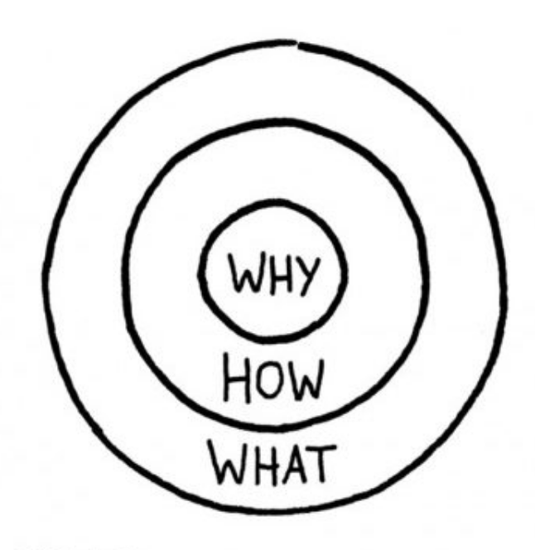

Slide 30
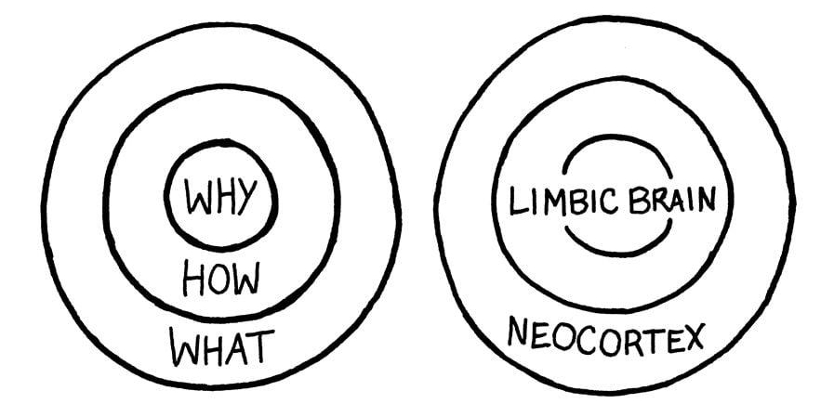

Slide 31
A Photo Album for Safety
(Personalizing Safety)

Slide 32
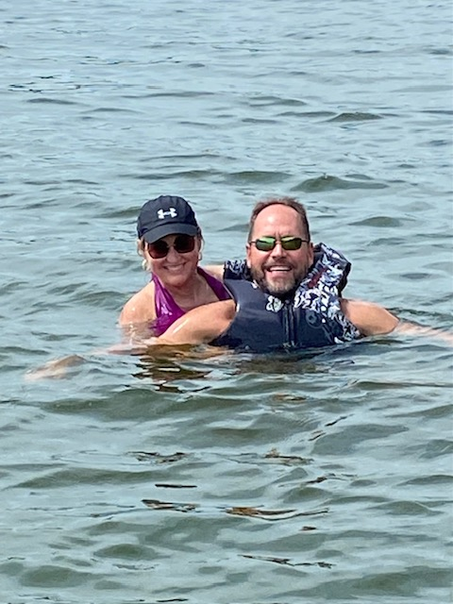

Slide 33
The Bus
(Could be the most powerful business metaphor of all time!)
How does it relate to your Safety Programs?

Slide 34
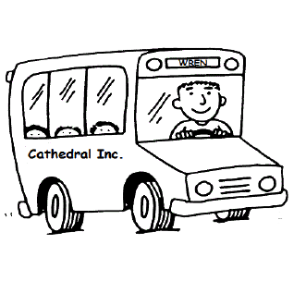
Right People on the Bus (Recruitment/Selection/Safety Orientation)
Right People in the Right Seat (Alignment) (Wrong People in Wrong Seats=Accident waiting to happen!)
Wrong People off the Bus! (If they’re not ever going to be Safety Advocates)

Slide 35
Engagement (a Disengaged worker is a candidate for an accident)

Slide 36
ENGAGEMENT
Annual Gallup Poll
26% of employees are Fully Engaged
55% of employees are Partially Engaged
19% of employees are Totally Disengaged

Slide 37
REASONS FOR EMPLOYEE ENGAGEMENT
A Personal Relationship with Her/His Immediate Supervisor
The Opportunity to “Get In the Game” & Apply One’s Skills/Talents (Right Seats)
To Feel Appreciated
Friends At Work

Slide 38
Clear Expectations
Materials and equipment to do one’s work right.
In the last seven days, recognition or praise for doing good work.
In the last six months, someone at work has talked about progress. (A Conversation; Not a Poop Sandwich….including Safety)

Slide 39
Motivation (an Unmotivated worker is a candidate for an accident)

Slide 40
Motivation 1.0

Slide 41
1.0 Doesn’t Work Anymore!
Carrot
Sticks

Slide 42
Motivation 2.0

Slide 43
2.0 Works!
Autonomy
Mastery
Purpose

Slide 44
Safety & Teams

Slide 45
Research has shown those in positive team environments have fewer accidents and health care lower than those of their peer groups who are not in great team environments. Stanford & University of Michigan

Slide 46
An Accurate Assessment of where our Teams/Organizations are and responding accordingly.

Slide 47
Super Safe Work-places
Perform
Norm
Storm
Form

Slide 48
Needs/Behaviors of each Stage

Slide 49
NEEDS/BEHAVIORS
Stages of Team Growth
“Real” orientation
Goals, Roles, Objectives, Mission, Vision, Key Milestones, Safety Culture
Management (vs. Leadership) at this point…
FORM

Slide 50
NEEDS/BEHAVIORS
Stages of Team Growth
Conflict Resolution
Establish Norms for Storming
Confidentiality
Appreciation of Differences (Drivers, Analyticals, Expressives, Amiables)
Protect Self-Esteem
Create a Culture of Positive & Needed Storming
Patience
Attack Issues; Not Individuals
Safe Place
STORM

Slide 51
The Conflict Continuum
Negative, Mean Spirited, Harsh Conflict
No Conflict
Artificial Harmony
Most Teams Reside Here
Ideal
Recovery: A Real Possibility
Recovery:
Very Difficult

Slide 52
NEEDS/BEHAVIORS
Stages of Team Growth
Mild Celebration (“We’re starting to click.”)
Praise
Availability
Feedback
NORM

Slide 53
NEEDS/BEHAVIORS
Stages of Team Growth
Gravitas vs. Arrogance
Swagger vs. Strutting
Celebration
Avoid Burnout
Avoid Complacency
Realize the Fluid Nature of Team Growth (You’ll be back to FORM at some point)
PERFORM

Slide 54
Customizing Your Safety Message

Slide 55
Task
Analytical
Driver
Ask
Tell
Amiable
Expressive
People

Slide 56
Safety, Stress & Communication

Slide 57
Managing/Leading Safety Programs can be Stressful

Slide 58
Task
Analytical
Withdrawing
Driver
Autocratic
Ask
Tell
Amiable
Acquiescing
Expressive
Attacking
People

Slide 59
Stressed Out=Accidents

Slide 60
Well-Ordered Souls

Slide 61
Stress Resistant People
They take personal control.
They are tasked-involved.
They make wise lifestyle choices.
They seek social support.
5. They have a sense of humor

Slide 62
They have religious values.
7. They are optimistic.

Slide 63
And Speaking of Optimism…

Slide 64
Positive vs. Negative Reinforcement

Slide 65
NHL Winnipeg Jets staff charted videos they showed the team the previous season and tracked the results in the subsequent games. They labeled each clip in one of the three categories:
Positive Clip, Teaching Clip, Negative Clip

Slide 66
“We realized that we were getting results and seeing more success when we were showing more positive clips.”
Winnipeg Coach Paul Maurice

Slide 67
Behavior is repeated to the extent it is Reinforced.

Slide 68
Breakthrough Safety is about
Reducing Interference

Slide 69
Interference
The dialogue that goes on in our minds that distract us from what we really need to pay attention to (Safety).
Interference can show up in anything we do and shuts down the ability to use the knowledge we possess.
Interference reduction/elimination is what separates World Class Safety Programs from others.

Slide 70
The One Thing that can have the Biggest Impact on our Safety Culture!

Slide 71
One Meaningful Conversation with Each Employee Each Week!
Gallup-Culture Shock book

Slide 72
Weekly Debriefs
What went well this week?
Where did we get stuck?
What do we need to focus on next week?

Slide 73
WHEN?
In addition to WHAT/HOW, etc.

Slide 74
Timing
Time-of-Day can explain 20 percent of the variance in human performance on work related tasks (often doing the “wrong work” at the “wrong time.”)
We simply don’t take issues of “When” as seriously as we take questions of “What.”

Slide 75
Circadian Rhythm
Our bodies follow a daily rhythm controlled by an internal clock in our brain.
Every morning when we open our eyes, the biological clock resets itself for another 24-hour period.
Our internal clock triggers a release of hormones (Cortisol, Melatonin).
Our internal clock triggers the rise and fall in our attention and mental ability.

Slide 76
Larks, Owls & Third Birds
We don’t all experience a day in precisely the same way. Each of us has a “chronotype” ---a personal pattern of circadian rhythms that influences our physiology and psychology…..and our Safety Programs.

Slide 77
Early chronotypes (Larks): Rise and feel energized during the day but wear out by evening. (14%)
Late chronotypes (Owls): Preferably wake long after sunrise, not “morning” people and don’t begin peaking until late afternoon or early evening. (21%)
Third Birds: Somewhere in the middle. (65%)

Slide 78
Three Stages (over the course of 16 waking hours)
Peak (High alertness & Energy)
Trough (Hit a Wall/Alertness & Energy wanes)
Recovery (Boost/Second Wind)

Slide 79
Bermuda Triangle of the Day
Between 2pm-4pm
Worst time of day: 2:55pm
Intelligence, judgement and productivity decrease.

Slide 80
A Scary Example!

Slide 81
Healthcare in the Afternoon
Patients are three times more likely to receive a potentially fatal dose of anesthesia.
Patients are more likely to die within 48 hours of surgery.
Gastroenterologists find fewer polyps during colonoscopies.
Internists are 26% more likely to prescribe unnecessary antibiotics for viral infections.
Nurses are 10 percent less likely to wash their hands before treating patients.

Slide 82
And in Closing….

Slide 83
The Safety Dedication

Slide 84
Safety Dedication
Safety Managers/Leaders
Do you acknowledge you have been charged, have the honor and the responsibility of caring, protecting and managing/leading our safety program in such a way that all employees go home to their families safe…..
If So, Reply We Do!

Slide 85
Safety Dedication
All Employees
Having just heard the public acknowledgement and commitment of these safety managers/leaders, do we agree to support and partner with them by creating/supporting an environment and culture where all employees go home to their families safe…
If So, Reply We Do!

Slide 86
Safety & Hot Water

Slide 87
212 DEGREES of Your Safety Program
At 211 degrees, Water is Hot.
At 212 degrees, it boils.
And with boiling water, comes steam…
And with steam, you can power a train.
You can produce energy for the world.
You can practice these skills necessary for true transformation!
One extra degree makes all the difference!
But you must do within 72 hours!

Slide 88
The Rule of 72
If we don’t implement an idea/concept within 72 hours, the odds of us ever implementing are greatly reduced!

Slide 89
GregCokerDevelopment.com
ibuildcathedrals@gmail.com
270.223.8343

