Slide 1
IAAP
Aggregate Miner Safety Conference
Silica Exposure Testing
December 5, 2023
Kimberly A. Hoppe Parr, PhD, CIH
GZA GeoEnvironmental, Inc.

Slide 2
Learning Objectives
Background: Silica.
Conducting an exposure assessment.
Evaluate sampling results.
Control exposures.

Slide 3
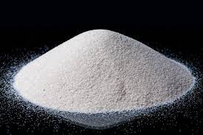
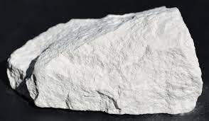
What is silica?
Various types
Quartz, cristobalite and tridymite.
Most abundant form is quartz
Silica can occur in crystalline and amorphous forms
Primary commercial product categories
Sand and gravel
Quartz crystals
Diatomites
IARC 2012

Slide 4
Operations That Do or May Involve Silica
Industrial sand operations
Sand and gravel aggregate operations
Limestone aggregate operations
Slag and concrete recycling operations
Ready mix concrete operations
Clean Construction Demolition Debris (CCDD) operations
Extraction and Processing

Slide 5
Respirable crystalline silica (RCS)
MSHA and OSHA definition
Quartz, cristobalite and/or tridymite contained in airborne particles that are determined to be respirable by a sampling device designed to meet the characteristics for respirable-particle size-selective samplers specified in the International Organization for Standardization (ISO) 7708:1995: Air Quality-Particle Size Fraction. (MSHA Proposed Rule and 29 CFR 1910.1053)

Slide 6
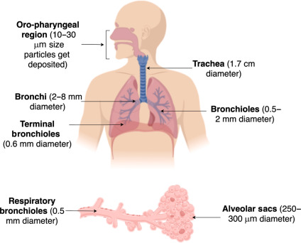
Respiratory System
Upper Respiratory:
Oral/nasal cavity
Lower Respiratory:
Trachea/ bronchi
Alveolar region
Image: Thakur et al. 2020

Slide 7
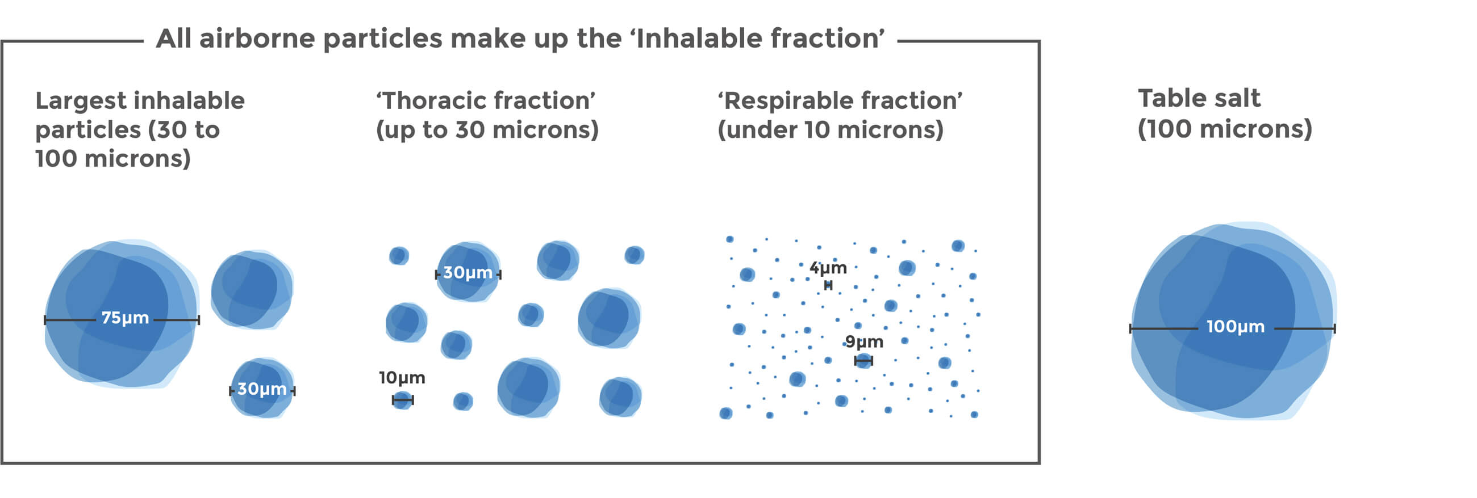
Respirable crystalline silica
Respirable- size fraction capable of penetrating to the lower gas exchange region of the lungs.
Image: https://safesilica.eu/respirable-crystalline-silica/

Slide 8
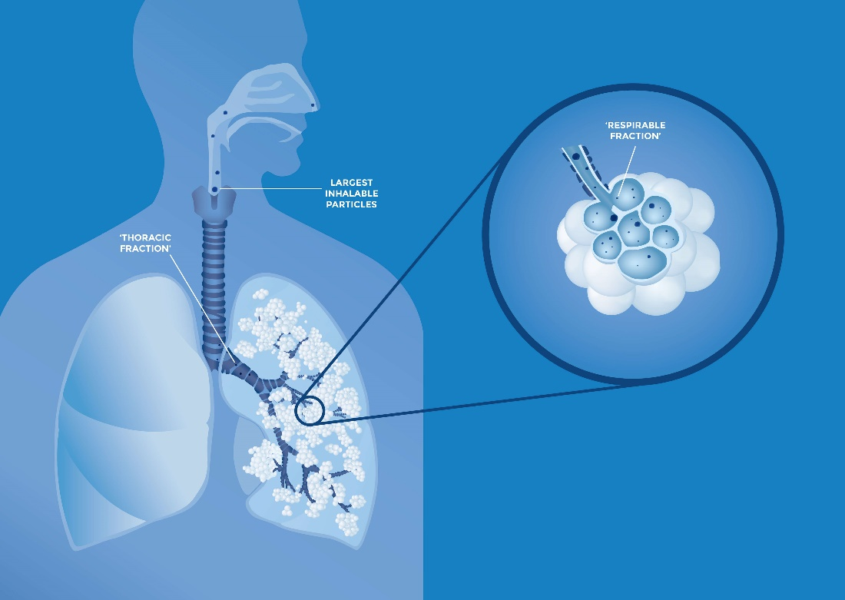
Lung penetration
Image: https://safesilica.eu/crystalline-silica-the-science/

Slide 9
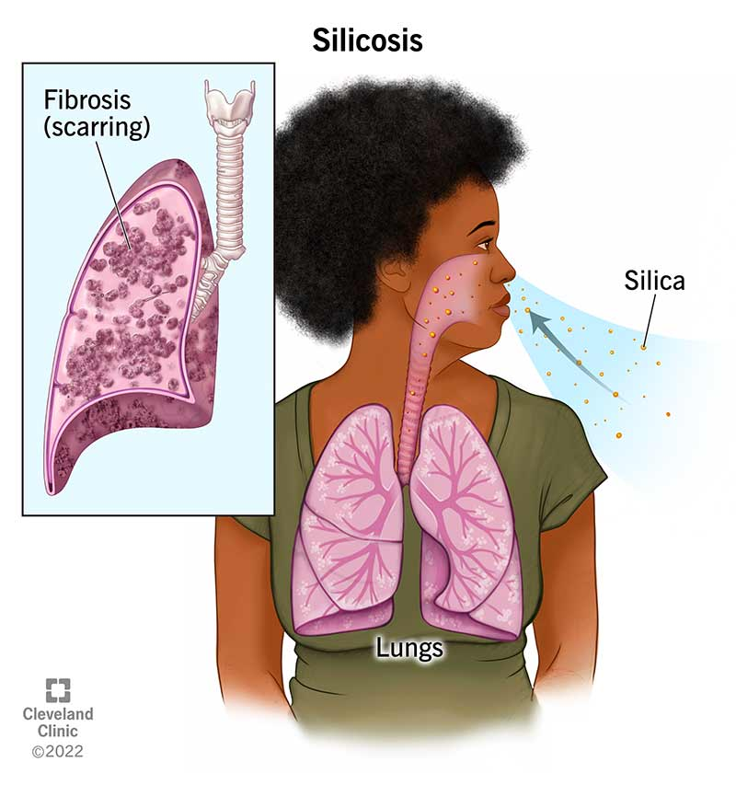
Potential Health Outcomes
Silicosis
Incurable lung disease
Pulmonary scarring (fibrosis).
Lung Cancer
Increased risk of developing lung cancer.
Chronic Obstructive Pulmonary Disorder (COPD)
Kidney Disease
OSHA 2023

Slide 10
Exposure Monitoring
Exposure
Measurable amount
Lung Penetration
Size selective
Deposition
Dose
Health Outcomes

Slide 11
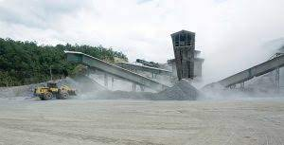
Occupational Exposure
MSHA
Silica dust is generated in most mining activities
cutting;
sanding;
drilling;
crushing;
grinding;
sawing;
scraping;
jackhammering;
excavating; and
hauling rock, gravel, and sand.
MSHA. Silica Fact Sheet.
Image: Pit and Quarry. 2023

Slide 12
Evaluate Occupational Exposure to RCS
Exposure
Lung Penetration
Deposition
Health Outcomes

Slide 13
When to sample?
The employer shall assess the exposure of each employee who is or may reasonably be expected to be exposed to respirable crystalline silica at or above the action level in accordance with either the performance option in paragraph (d)(2)(ii) or the scheduled monitoring option in paragraph (d)(2)(iii) of this section.

Slide 14
When to sample?
Section 60.12 (a) –
Baseline sampling. The first action mine operators would take to assess miners’ exposures under the proposed rule would be to conduct baseline sampling. Baseline sampling would provide an initial measurement of respirable crystalline silica exposures that would be compared to the proposed action level and the proposed PEL to determine the effectiveness of existing controls and the need for additional controls.
MSHA Proposed Rule

Slide 15
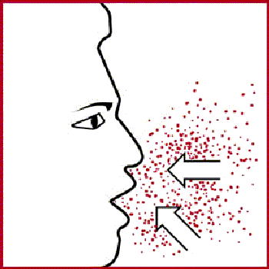
Initial Determination/ Baseline Sampling
The employer shall perform initial monitoring to assess the 8-hour TWA exposure for each employee
PBZ
reflect the exposures of employees on each shift, for each job classification, in each work area.
Sample similar exposure groups
Representative sampling

Slide 16
Planning Field Surveys and Sampling
Where, when, how long, whom, how many
Personal v. Area
Full shift v. task based
Similar exposure groups
Collection method and equipment
Regulatory requirements
Supplemental samples, bulk, and/or field blanks
Identify certified laboratory

Slide 17
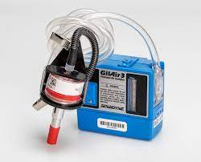
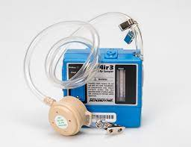
Personal Air Sampling
Air sampling pump
Calibrate
Standard methods
Flow rate
Duration
Sampling media
Cyclone
Parallel particle impactor (PPI)
Images: https://www.sgsgalson.com/silica/

Slide 18
Particle Size Selective Sampling
Inhalable (100 μm 50% cut-point)
upper airways (nose and throat)
Thoracic (10 μm 50% cut-point) -
Tracheobronchial regions
Respirable (3.5/4 μm 50% cut-point)
Gas exchange region (alveolar region)
Image: SKC

Slide 19
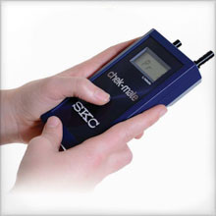
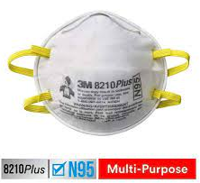
Air Sampling
Key Steps
Order equipment
Calibrate sampling pumps
Label sampling media
Record start time
Document work tasks, breaks, duration each performed
Record if any personal protective equipment (ppe) was worn
Record stop time
Field blanks
Post-calibrate sampling pumps
Follow chain of custody procedures to forward samples to a certified laboratory for analysis.

Slide 20
Air Sampling
Troubleshooting
Pump stops
Battery
Charge overnight prior to sampling
Bring extra(s) if possible
Hose blocked or crimped
Check samplers regularly
Sampling position
Breathing zone

Slide 21
Chain of Custody
Important information
Date sampled
Identify the individual who sampled
Sample ID
Sample duration or total volume collected
Analysis requested
Turn around time
Date and time submitted to the laboratory

Slide 22
Analytical Methods
Certified Laboratory
Analytical Methods
NIOSH 7500/OSHA ID-125; XRD
NIOSH 7602 and 7603; IR
MSHA Method P-2 and P-7

Slide 23
Analytical Results
Sample ID
Volume
Units
Notes or laboratory qualifiers

Slide 24
Evaluation of Hazards: Occupational Exposure Limits
Occupational Exposure Limits (OELs)
Regulatory
OSHA
MSHA
Federal Agency- Research
NIOSH
Consensus Organizations
ACGIH

Slide 25
Occupational Safety and Health Administration (OSHA)
OSHA Permissible Exposure Limits (PEL)
29 CFR 1910.1000, tables Z-1, Z-2, and Z-3
Time weighted average (TWA)
The employee's average airborne exposure concentration in any 8-hour work shift of a 40-hour work week which shall not be exceeded
Level of exposure established as the highest level of exposure an employee may be exposed to without incurring the risk of adverse health effects.

Slide 26
OSHA
In 2016 OSHA updated its RCS Standard
Lower PEL and action level for RCS exposures
OSHA PEL for RCS = 50 μg/m³
OSHA Action Level for RCS = 25 μg/m³
Applicable to general industry, construction, and maritime
Additional requirements included:
Construction (1926.1153)
General Industry and maritime (1910.1053)

Slide 27
Mine Safety and Health Administration (MSHA)
For MNM mines,
The existing exposure limit for quartz is 100 μg/m³ for a full-shift exposure, calculated as an 8-hour TWA.
For coal mines,
There is no separate standard for RCS.
Regulated through reductions in the overall respirable coal mine dust standard.
Limit miners’ exposures to RCS using
Engineering controls as the primary means of suppressing, diluting, or diverting dust generated by mining activities.

Slide 28
MSHA- Proposed Standard
Lower PEL and action level for RCS exposures
MSHA PEL for RCS = 50 μg/m³
MSHA Action Level for RCS = 25 μg/m³
Medical surveillance
MNM and coal miners
Early detection
Respiratory protection
ASTM 2019- “Standard Practice for Respiratory Protection,”
MSHA- Silica Fact Sheet

Slide 29
NIOSH
Non-Regulatory Occupational Exposure Limits
National Institute for Occupational Safety and Health (NIOSH)
NIOSH Recommended Exposure Limits (RELs)
10 hour work day, 40 hour work week
NIOSH REL for RCS = 50 ug/m³

Slide 30
ACGIH
American Conference of Governmental Industrial Hygienists
ACGIH Threshold Limit Values (TLV)
8-hour Time Weighted Average (TWA)
Airborne concentration which most workers can be repeatedly exposed during an eight-hour work day over a working lifetime and experience no adverse health effects
ACGIH TLV for RCS = 25 ug/m³

Slide 31
Occupational Exposure Limits
Agency/Group | Standard
OSHA | 50 μg/m³
MSHA (existing) | 100 μg/m³
MSHA (proposed) | 50 μg/m³
NIOSH | 50 μg/m³
ACGIH | 25 μg/m³

Slide 32
Evaluation of Hazards: Occupational Exposure Limits
Compare sampling results to the Occupational Exposure Limits
Calculate a Time Weighted Average
TWA = (C₁T₁) + (C₂T₂ ) …+ (C_{n}T_{n})
Total Time (8 hours)

Slide 33
EXAMPLE: TWA Calculation
Calculation of an 8-hour TWA
1 hours at 200 µg/m³
5 hours at 0.1 µg/m³
2 hours at 0 µg/m³
Did we exceed the PEL for RCS?

Slide 34
EXAMPLE: TWA Calculation
TWA = (C₁T₁) + (C₂T₂ ) …+ (C_{n}T_{n})
Total Time (8 hours)
TWA = (1 hr x 200 µg/m³) + (5 x 0.1 µg/m³ ) + (2 x 0)
8 hours
TWA = (200) + (0.5)+(0)
8 hours
TWA = 25.1 µg/m³
1 hours at 200 µg/m³
5 hours at 0.1 µg/m³
2 hours at 0 µg/m³
RCS
OSHA PEL = 50 µg/m³
MSHA PEL = 100 µg/m^{3 **}
**MSHA Proposed PEL = 50 µg/m³

Slide 35
Occupational Exposure Limits
PEL (Permissible Exposure Limit)
Regulatory Limit set by OSHA and MSHA
REL (Recommended Exposure Limit)
Recommended limit set by NIOSH
TLV (Threshold Limit Value)
Recommended limit set by ACGIH
Action Level

Slide 36
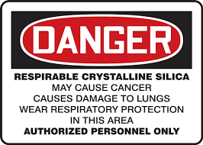
Action Level and PEL
Below the Action Level
employer may discontinue monitoring for those employees whose exposures are represented by such monitoring.
Above the action level but at or below the PEL,
the employer shall repeat such monitoring within six months of the most recent monitoring.
Exceeding the PEL
the employer shall repeat such monitoring within three months of the most recent monitoring

Slide 37
Employee Notification
Informing Workers
Inform workers about sampling and rationale.
OSHA requires that results indicating over exposure be
communicated to workers, ethical to provide all data.

Slide 38
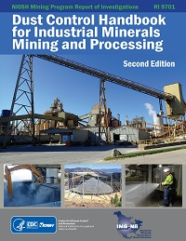
Evaluate Occupational Exposure to RCS- Control Exposures
Exposure
Lung Penetration
Deposition
Health Outcomes

Slide 39
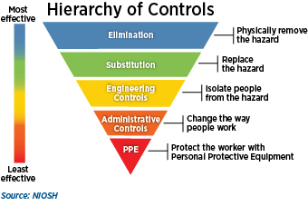
Control of Occupational Hazards

Slide 40
Evaluation of Hazards: Occupational Exposure Limits
STEL/ Ceiling
limit
Concentration/ Level
8-hr TWA
Real-time sampling
Time
(minutes)
480

Slide 41
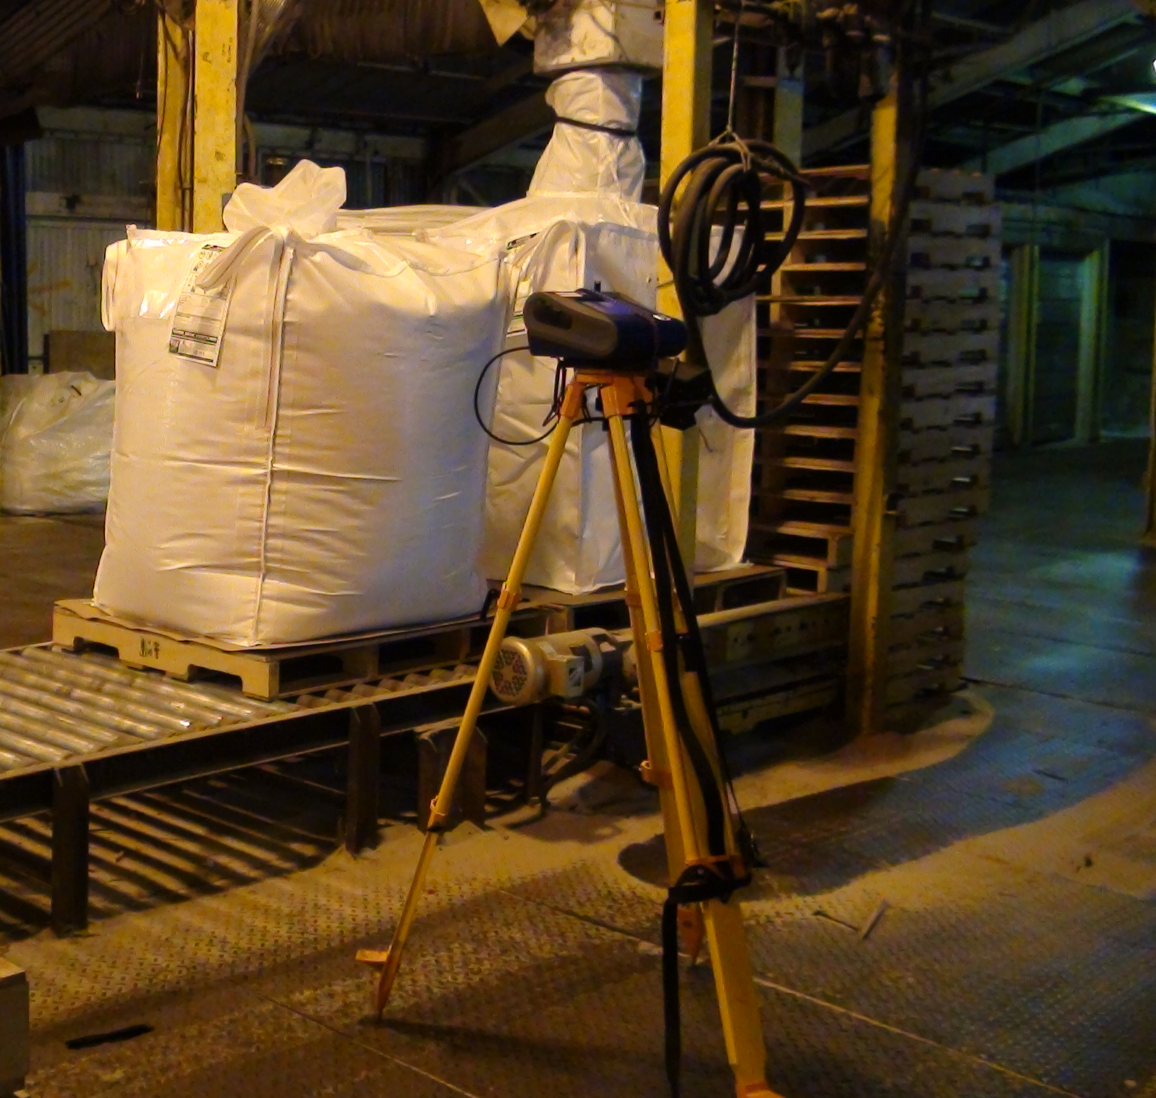
Task-Based Sampling
Identify specific tasks where exposure(s) may occur
If employee does not interact with silica regularly
If you exceed action level/PEL
Aid in identifying major contributing factors to overall TWA

Slide 42
Task-Based Monitoring
Task based
Test
- Short term sampling
- Focus on a specific task or operation
Real time monitoring
- Immediate results
- Measure peak exposure(s)
- Recommend controls or work requirements
Evaluate

Slide 43
Control of Hazards
Evaluate Control Effectiveness
Periodic testing of ventilation systems,
local exhaust.
Sampling after the implementation of engineering controls.
Inspection, cleaning and maintenance of PPE.
Review of administrative programs annually.

Slide 44
Reassessment of Exposures
Change in the
production,
process,
control equipment,
personnel, or
work practices
That may reasonably be expected to result in new or additional exposures at or above the action level, or
When the employer has any reason to believe that new or additional exposures at or above the action level have occurred.

Slide 45
Notice of Proposed Rule Making
Update to the MSHA silica standard
July 13, 2023
Permissible Exposure Limit to respirable crystalline silica at or below 50 µg/m3 for a full shift exposure, calculated as an 8-hour time weighted average.
Update to other components of the standard
Improve Respiratory Protection
Comment Period closed September 11, 2023
Notes:
Tomorrow’s Presentation:10:30-11:15 MSHA's New Silica Rule, presented by Nick Scala (Conn Maciel Carey, Chair MSHA Workplace Safety Group)

Slide 46
Thank you!
Kimberly A. Hoppe Parr, PhD, CIH
Senior Project Manager
Occupational and Environmental Health Scientist/ Toxicologist
GZA GeoEnvironmental, Inc.
17975 West Sarah Lane, Brookfield, WI 53045
(262)754-2584
kimberly.parr@gza.com

