Slide 1
Magic of Fire
Wes Taylor

Slide 2
Why seconds count

Slide 3
Christmas Tree

Slide 5
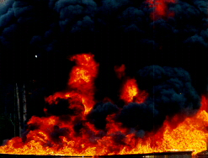
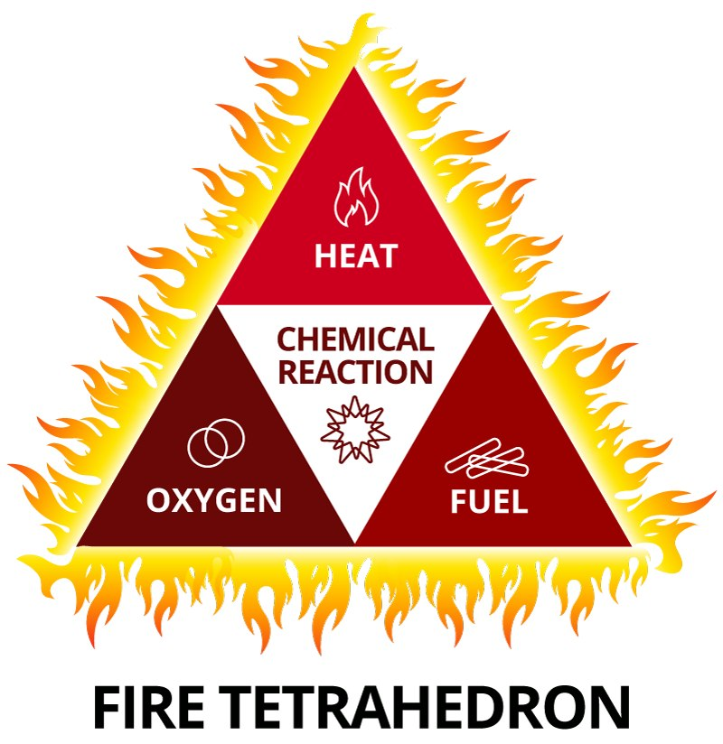
The Fire Triangle
Three things are needed for conditions to be right for a fire to get started.
Now represents the “smoldering” mode of combustion.
oxygen
fuel
heat

Slide 7
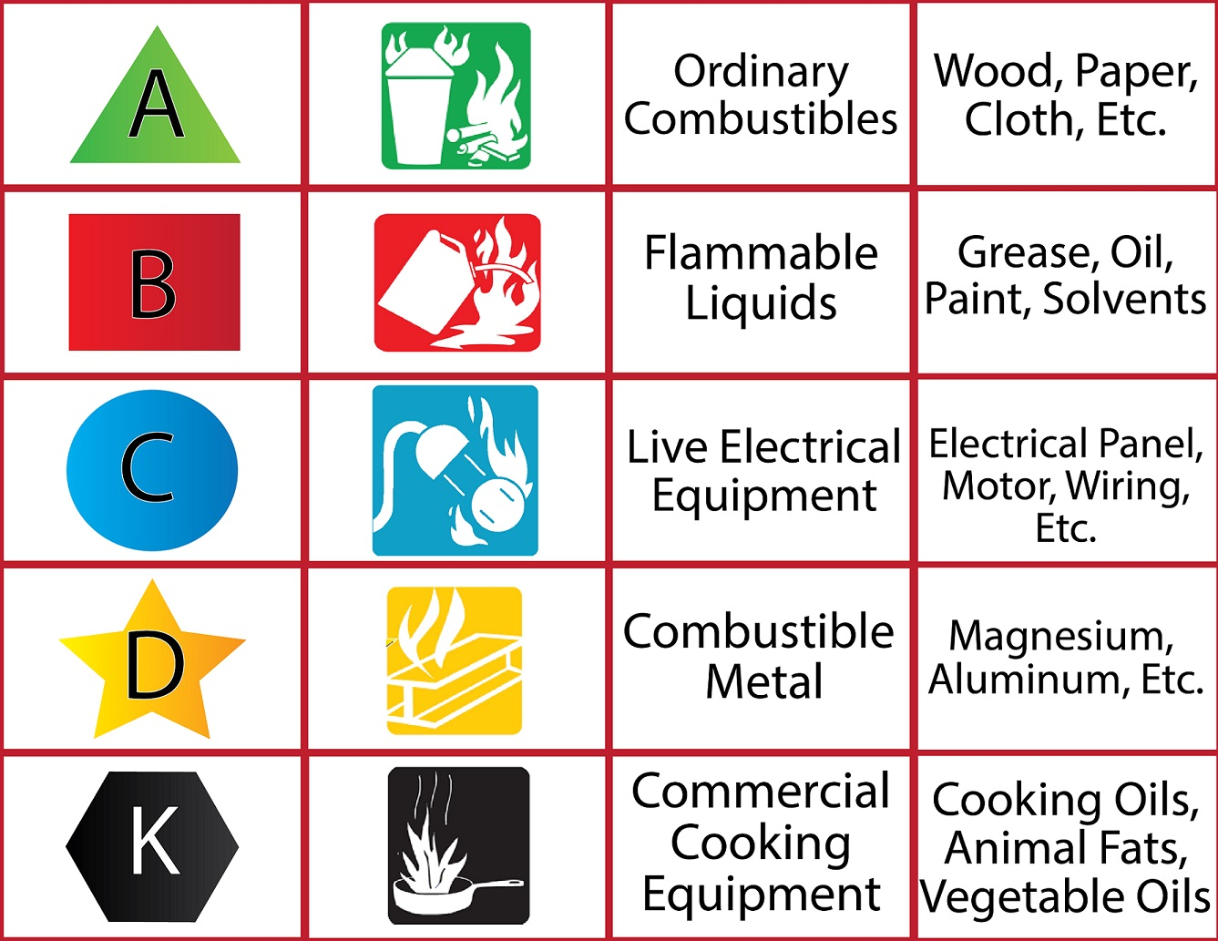

Slide 8
IECC – Booth #

