Slide 1
IAAP Innovation in Safety and Health Leadership Award 2023

Slide 2
Workplace Exams
New Frontier Materials – Bluff City has adopted a new way for employees and management to conduct workplace exams and report hazards at the mine.
This method, called the “cone and tag” method at the mine, has reduced NFM’s injury rates and citations over the past two years.
The next several slides will show you how it works.

Slide 3
Communication is the key to success
Complacency
Forgetfulness
Lack of concentration
Not focused on the task at hand
Too many irons in the fire

Slide 4
Discovering a hazard
Traveling underground, a piece of loose is discovered on the travel way.

Slide 5
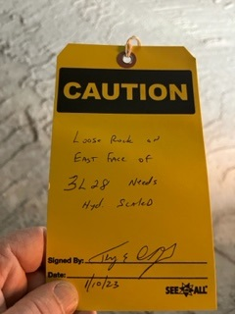
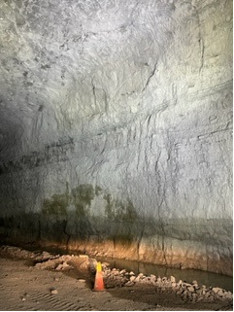
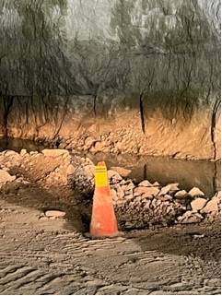
Identifying the Hazard
A tag is used to describe the employee, location, date and nature of the hazard. Then the tag is placed onto a cone to make everyone that travels in that area aware of the hazard. The hazard is also noted on the initiators employee's workplace exam.

Slide 6
Hazard is Removed
After the hazard is identified, the proper methods are followed to remove the hazard. In this case, a mechanical scaler was brought to the area to remove the loose ground condition. The individual who corrects the hazard also notes it on their workplace exam

Slide 7
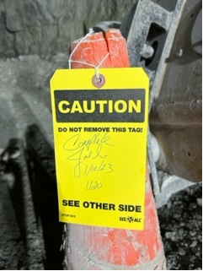
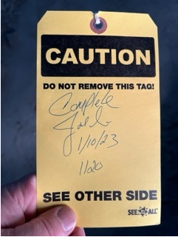
After the Hazard is Corrected
After the hazard has been corrected, the individual who fixed it will sign and date the hazard on the opposite side of the tag.

Slide 8
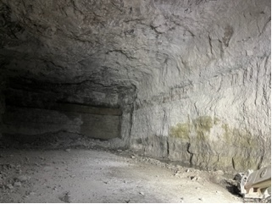
After the Hazard is Corrected
After the hazard is corrected, the employee who initiated the hazard or a member of management, is notified that it has been corrected and he/she then verifies that the correct hazard has been properly corrected (follow through or what I call the full circle effect). If all is found to be satisfactory, the tag and cone are then removed from the area.

Slide 9
Cone and tag Method used on the surface
The process started in the underground mine, and over time was adopted throughout the entire operation.
Cones or caution tape are used in the surface crushing plant to signify hazards

Slide 10
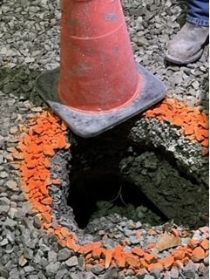
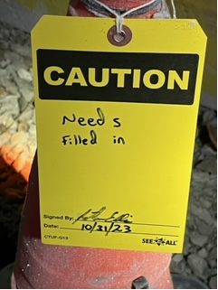
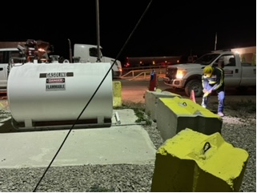
Surface Hazard

Slide 11
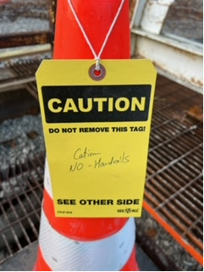
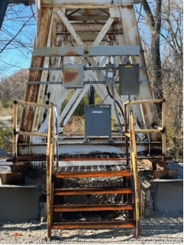
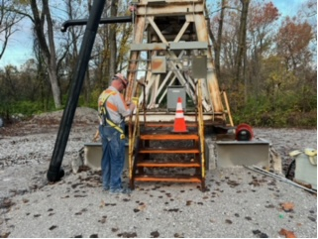
Surface Hazard

Slide 12
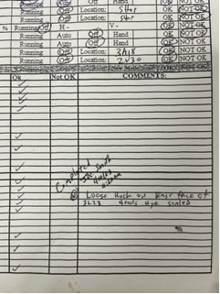
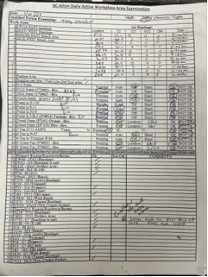
Completed Workplace Exam
After all hazards associated with the cone and tag are fixed, the tag makes its way back to the initiator and the information (who corrected the hazard and when) is noted on the initiator employees workplace exam. The tag can also be stapled to their workplace exam for further documentation.

Slide 13
Cone and Tag Method Impact
The mine implemented the cone and tag method in late 2020 after 2 back to back MSHA inspections that left us with 20+ citations a piece, including a D citation and D order for unconsolidated ground conditions.
Prior to the implementation, the mine in 2020 received 54 citations
2021 they received 6, 2022 they received 12 citations, 2023 8 citations. 1 S&S citation in that 3-year period.
Injuries also reduced after implementation
2020 – 1 Lost Time Injury, 2 Recordable Injuries
2021 – 0 Lost Time Injuries, 0 Recordable Injuries
2022 – 0 Lost Time Injuries , 1 Recordable Injury
2023 – Year to date- 0 Lost time, 0 recordable injuries

Slide 14
Cone and Tag Method
The method has proven to be successful for NFM Bluff City and has been implemented at all of New Frontiers underground operations, resulting in a similar impact.
The method ensures that everyone from management to the hourly employee are aware of hazards, and it ensures that proper workplace exams are being documented.
NFM Bluff City will continue this method and begin incorporating it at all sites company wide.

Slide 15
Questions or comments?

