Slide 1
How to Use your Team’s Untapped Talent and Hidden Strengths

Slide 2
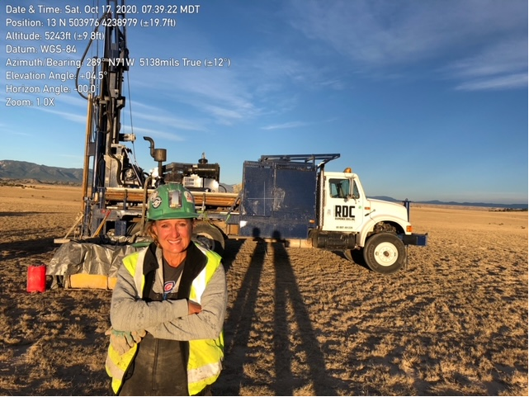
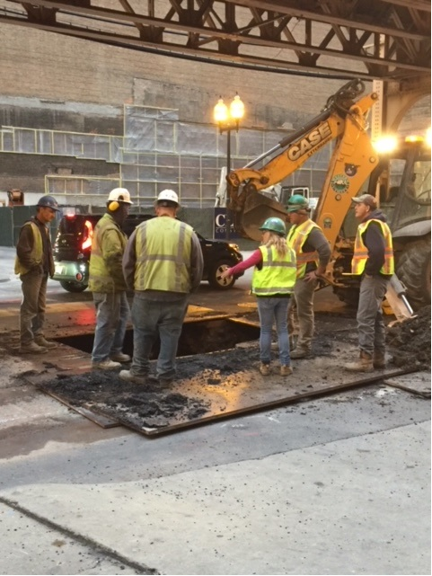
Panel Host: Anne Leslie
President
Raimonde Drilling Corporation
Addison, Illinois
v Certified: WBE / DBE / WOSB v
2nd Generation Owner of Raimonde Drilling (52 years in business)
34 years in drilling service across the United States
Roles in sales, book-keeping, accounting, maintenance, and field work
IAAP Board of Director for 25 years as Associate Director
MOM

Slide 3
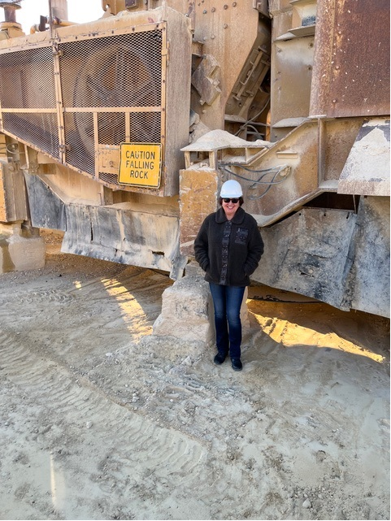
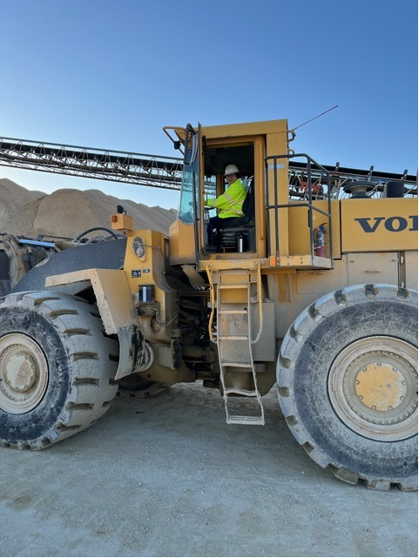
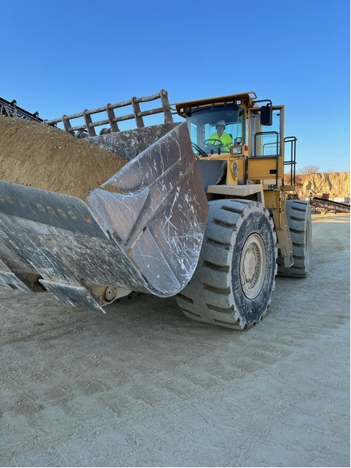
Maryann Macklin
Macklin Inc.
President
IAAP Board Member
Grew up in small town playing ( and later working) at family quarries
Circled back to family company after career in International Finance and Marketing
President of Macklin Incorporated – over 30 years in the industry
Outside interests: travel and commercial pilot
Goal to lead, inspire and give back to industry near and dear to my heart

Slide 4
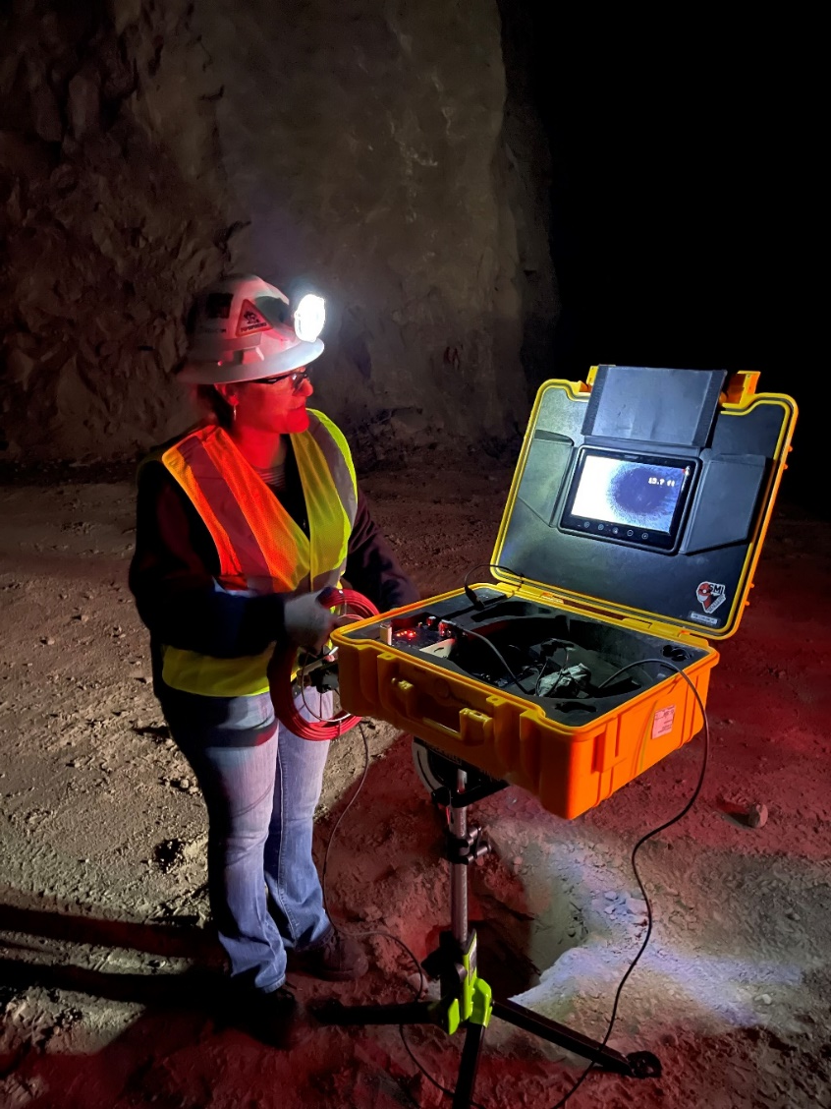
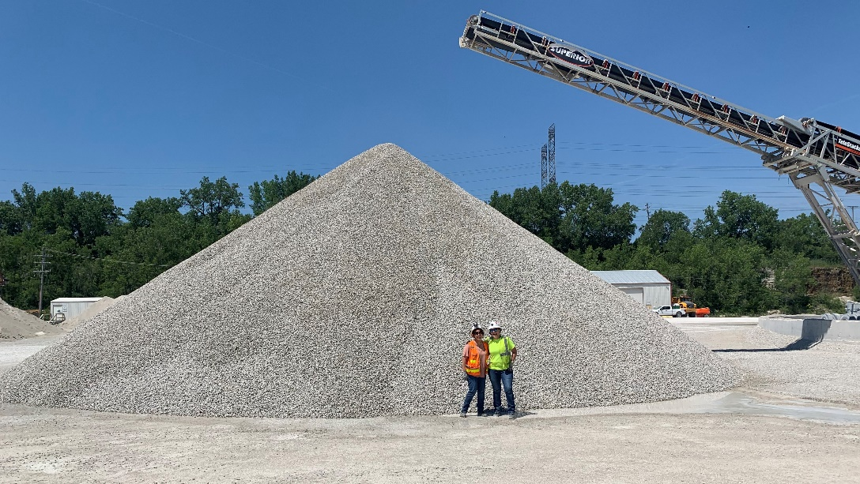
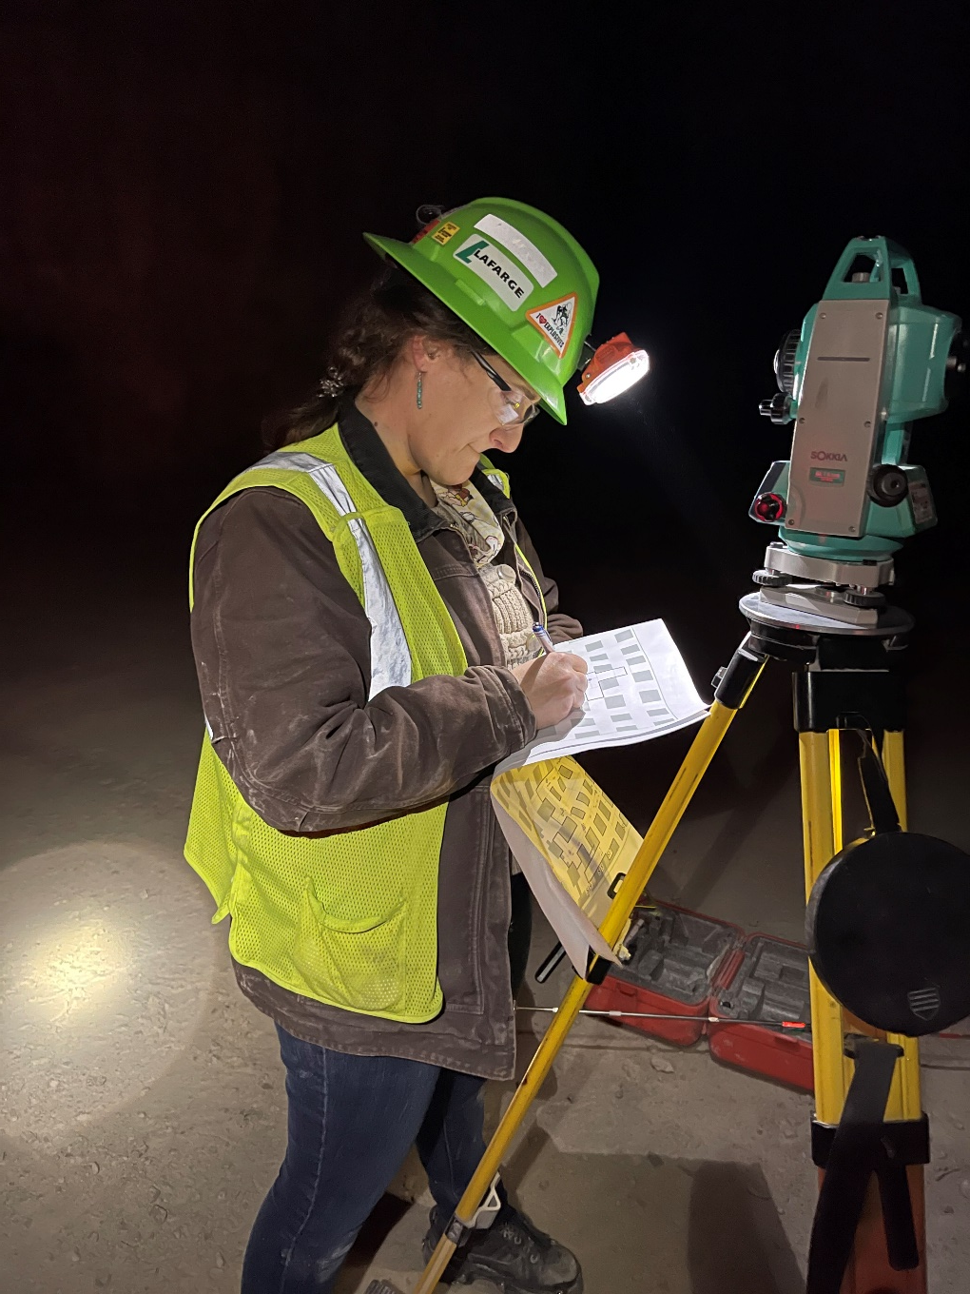
Becky Kazmierski PG
Mine Engineer II
Holcim
IAAP Public Information and Education Committee Chair
In Mining and Construction Materials Testing Industry since 1999
BS and MS in Geology and Licensed Professional Geologist in IL and IN
Worked as Quality Control (technician and supervisory roles) for Concrete and Aggregates; Independent PCC / HMA testing for City of Chicago DOT; and Concrete/Aggregate Petrographer
Currently underground mine engineer for a 2 million tons/year quarry
Active PIE Member since 2004 – Committee Chairperson for over 10 years

Slide 5
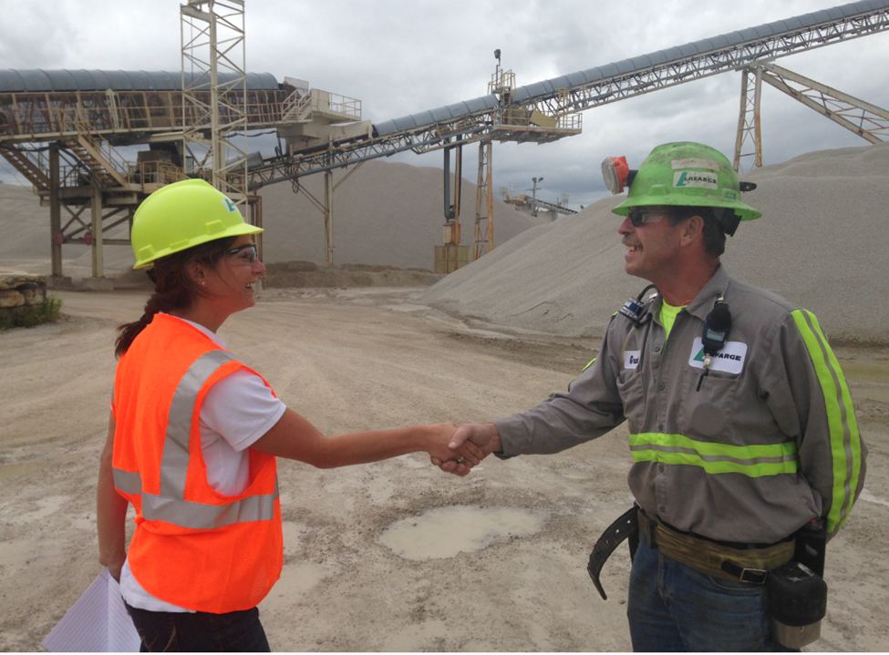
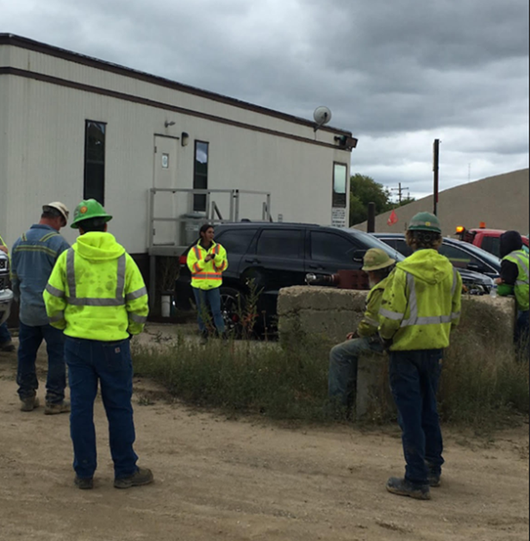
Angie Nickel, CSP
Regional Health and Safety Manager
Holcim
IAAP Safety Committee Chair
AIHA Chicago Section Secretary
10 years experience in the Mining and Construction Industry
Safety Manager for ~400 employees across 24 locations
Certified Safety Professional and Class A CDL holder
Learning and self betterment enthusiast
Always willing to try something new
Enjoys hockey, soccer and being a mom

Slide 6
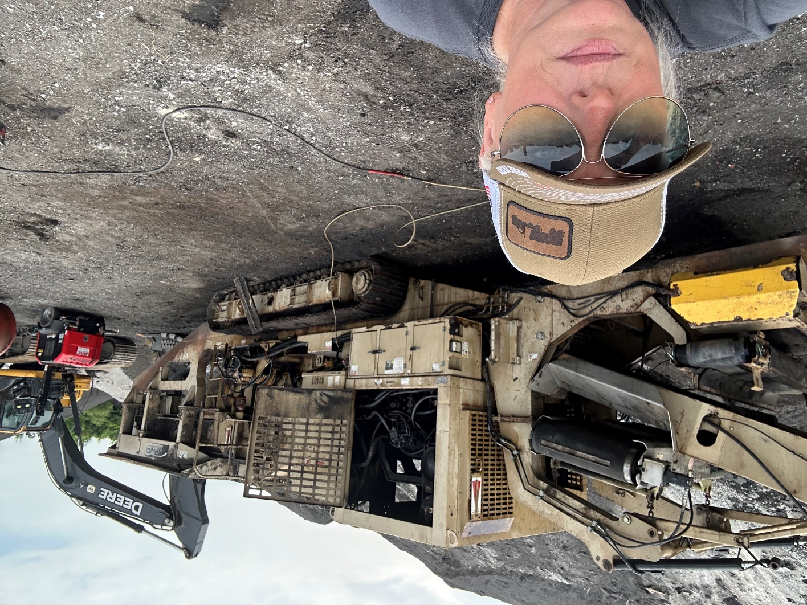
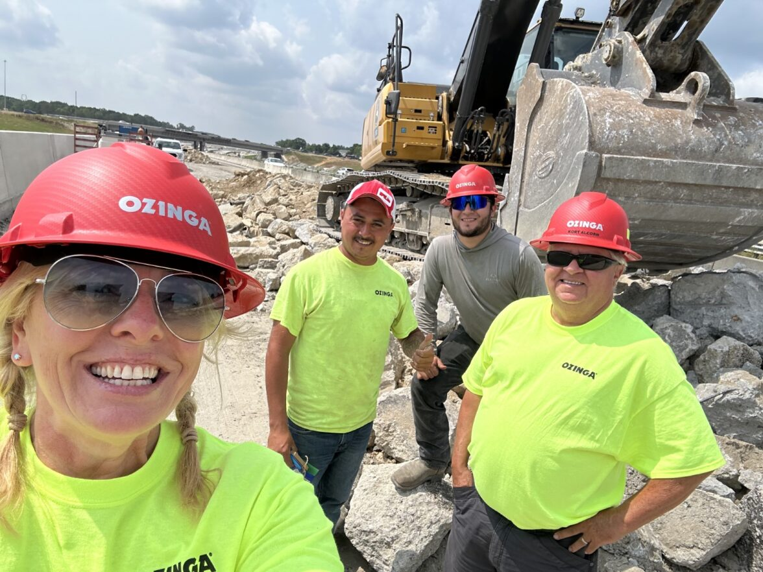
Carolynn Kloese
Sales and Process Analyst
Ozinga Materials
IAAP Sustainability Committee Chair
Entrepreneur, Business Owner, IAAP Sustainability Chair, Analyst, Farm Girl, Athlete, Student, Artist, Coach, Mother, Grandmother
I have been working in the construction industry for 25 years.
Sales, process, operational analyst
Goals: learn, collaborate, inspire, support, and rise. To encourage others that no matter what role they currently are in; that what they do is important.
That each of us have an opportunity to develop a path to success.

Slide 7
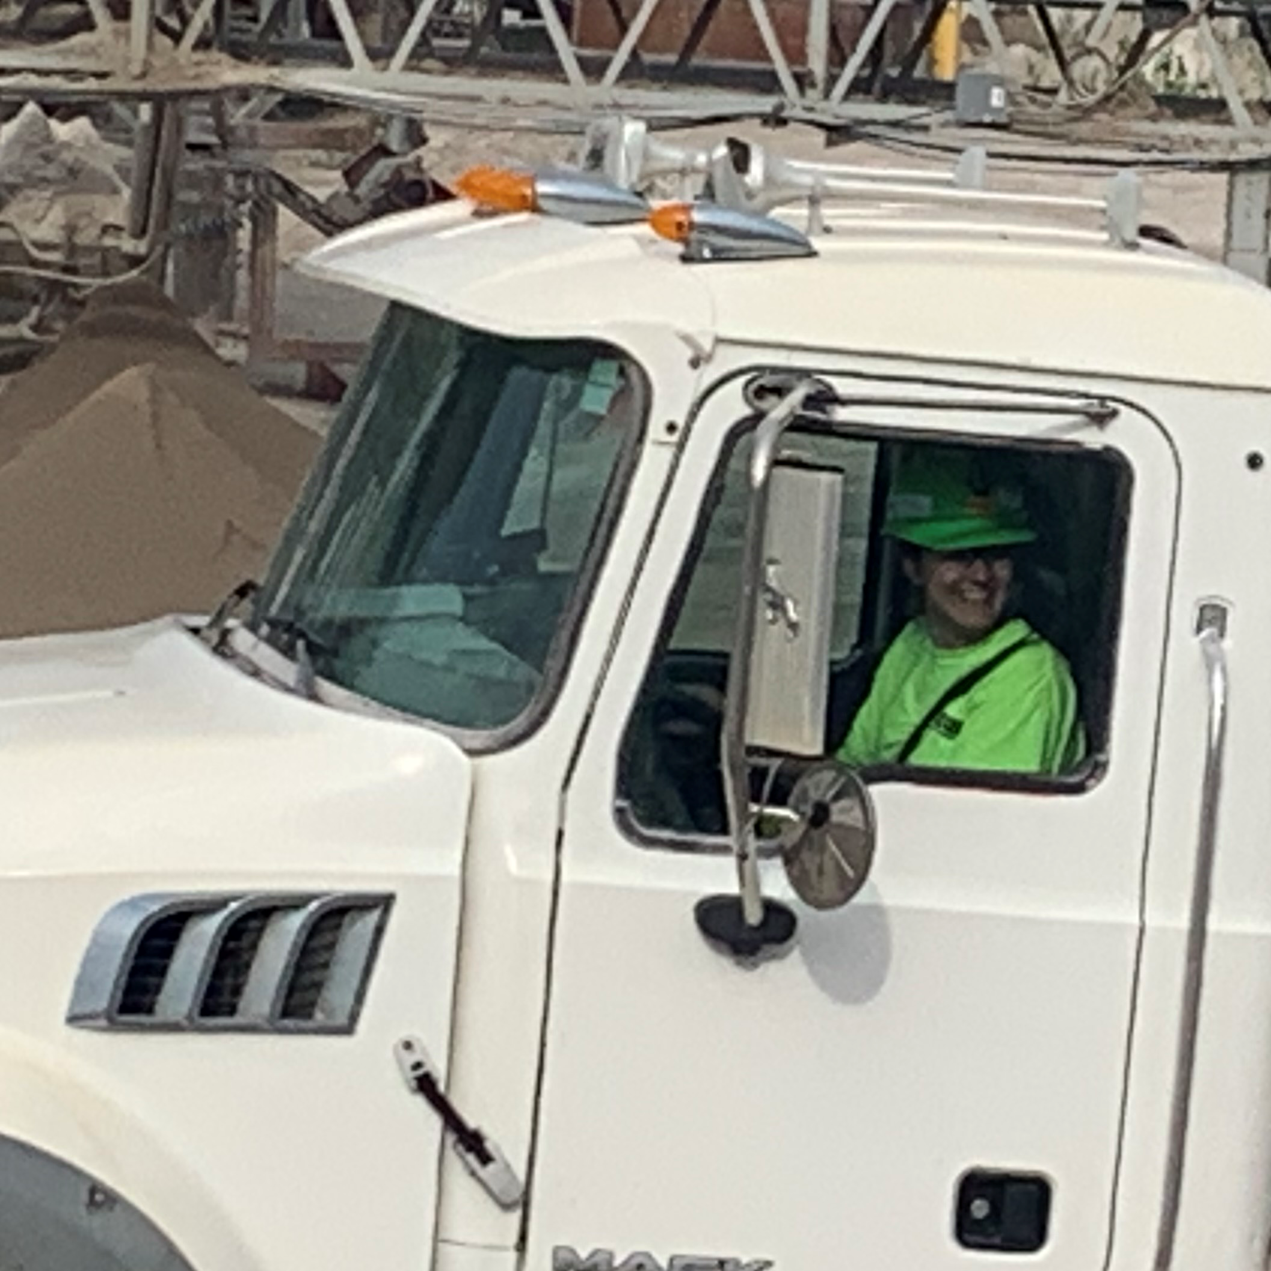
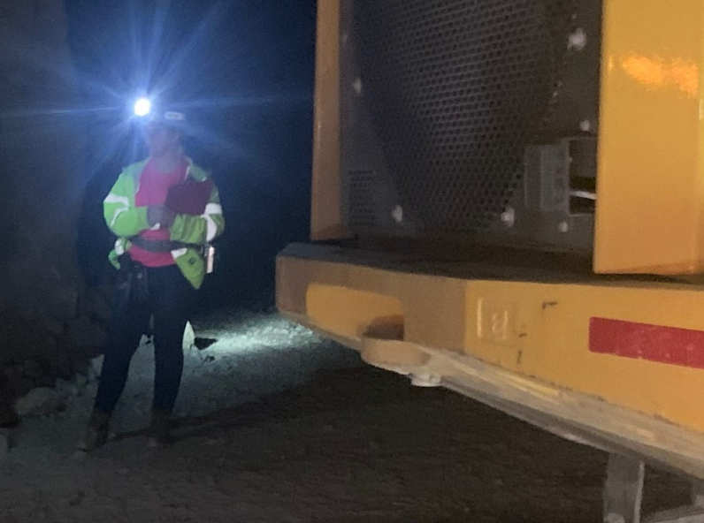
Kristina Lee
Operations Management
Vulcan Materials Company
IAAP 2023 Emerging Leader
Introduced to aggregates during Civil Engineering degree from Missouri S & T Rolla
Operations Management at Vulcan for 1.5 years
Oversee crew of 25 employees over 2 shifts at an underground mine
Track financials, monitor environmental compliance, enforce safety standards
Nominated and graduated the IAAP 2023 Emerging Leaders Program
Develop my people, identify strengths, utilize talents. Above all else, make it possible for coworkers to pursue their goals

Slide 8
I
NITIATE and
A
DVOCATE for
A
NOTHER’S
P
OTENTIAL

